Slide 1

Market Basket Analysis-USING NLP
A.SARVANI KANYAKA-192211795
CSA1337-theory of computation with logical model

Slide 2

Introduction to Market Basket Analysis
Market basket analysis is a powerful technique used to uncover hidden patterns and relationships in customer purchasing data. By analyzing the items that customers buy together, businesses can gain valuable insights into consumer behavior and make more informed decisions about product placement, promotions, and cross-selling opportunities. This introductory section provides an overview of the key concepts and applications of market basket analysis, setting the stage for a deeper exploration of the topic in the sections that follow.

Slide 3
0BJECTIVE
Finding items that buyers desire to buy is the major goal of market basket analysis. Market basket analysis may help sales and marketing teams develop more effective product placement, pricing, cross-sell, and up-sell tactics.

Slide 4
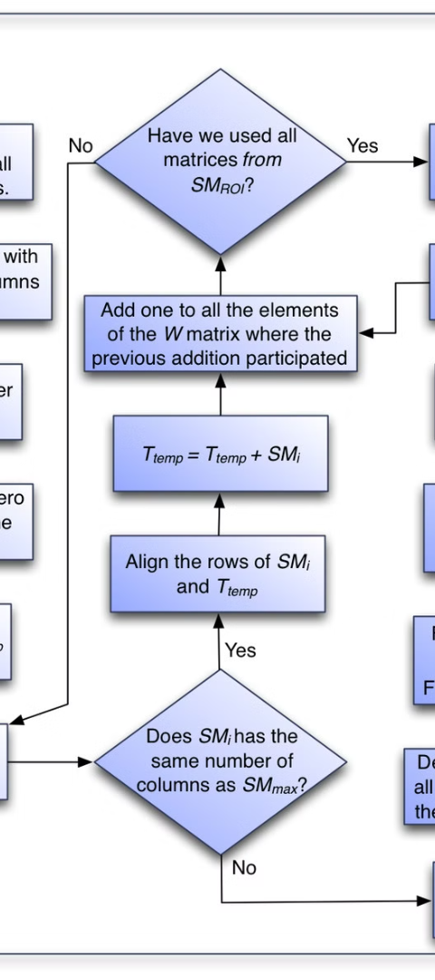
Problem Definition and Algorithm
1
Task Definition
The primary goal of market basket analysis is to identify associations between the items that customers purchase together. This information can be used to improve product placement, target marketing efforts, and optimize the customer experience. The task involves analyzing large datasets of customer transactions to uncover these hidden patterns and relationships.
2
Algorithm Definition
The most commonly used algorithm for market basket analysis is the Apriori algorithm, which uses a step-by-step approach to identify frequently occurring itemsets and their associated rules. The algorithm works by first identifying all individual items that meet a minimum support threshold, and then using these frequent itemsets to generate candidate rules that are evaluated for their confidence and lift.

Slide 5

Consider the following dataset and we will find frequent itemsets and generate association rules for them.
minimum support count is 2 minimum confidence is 60%
Step-1: K=1 (I) Create a table containing support count of each item present in dataset – Called C1(candidate set)
(II) compare candidate set item’s support count with minimum support count(here min_support=2 if support_count of candidate set items is less than min_support then remove those items). This gives us itemset L1.
Step-2: K=2
(II) compare candidate (C2) support count with minimum support count(here min_support=2 if support_count of candidate set item is less than min_support then remove those items) this gives us itemset L2.
Step-3:
(II) Compare candidate (C3) support count with minimum support count(here min_support=2 if support_count of candidate set item is less than min_support then remove those items) this gives us itemset L3.
Step-4:
Thus, we have discovered all the frequent item-sets. Now generation of strong association rule comes into picture. For that we need to calculate confidence of each rule.
Confidence – A confidence of 60% means that 60% of the customers, who purchased milk and bread also bought butter.
Confidence(A->B)=Support_count(A∪B)/Support_count(A)
So here, by taking an example of any frequent itemset, we will show the rule generation. Itemset {I1, I2, I3} //from L3 SO rules can be [I1^I2]=>[I3] //confidence = sup(I1^I2^I3)/sup(I1^I2) = 2/4*100=50% [I1^I3]=>[I2] //confidence = sup(I1^I2^I3)/sup(I1^I3) = 2/4*100=50% [I2^I3]=>[I1] //confidence = sup(I1^I2^I3)/sup(I2^I3) = 2/4*100=50% [I1]=>[I2^I3] //confidence = sup(I1^I2^I3)/sup(I1) = 2/6*100=33% [I2]=>[I1^I3] //confidence = sup(I1^I2^I3)/sup(I2) = 2/7*100=28% [I3]=>[I1^I2] //confidence = sup(I1^I2^I3)/sup(I3) = 2/6*100=33%
So if minimum confidence is 50%, then first 3 rules can be considered as strong association rules.

Slide 6
Experimental Evaluation
Methodology
Results
Discussion
To evaluate the effectiveness of market basket analysis, researchers often conduct experiments using real-world datasets from retailers, e-commerce platforms, or other sources. These datasets are preprocessed and analyzed using the Apriori algorithm or other market basket analysis techniques. The resulting association rules are then assessed based on their support, confidence, and lift metrics to determine the strength and significance of the identified patterns.
The findings of market basket analysis experiments can vary greatly depending on the nature of the dataset and the specific business context. However, common results may include the identification of complementary product pairings, the discovery of upselling or cross-selling opportunities, and the optimization of product placement and in-store promotions. These insights can have a meaningful impact on a business's bottom line and customer satisfaction.
While market basket analysis is a powerful tool, it is important to consider its limitations and potential challenges. For example, the quality of the results is highly dependent on the quality and completeness of the underlying data. Additionally, the algorithm can be computationally intensive, especially when dealing with large datasets or complex product relationships. Ongoing research in this field is focused on addressing these challenges and exploring new applications of market basket analysis in areas such as e-commerce, customer segmentation, and product recommendation systems.

Slide 7

Related Work
Academic Research
Industry Adoption
Market basket analysis has been a topic of extensive academic research, with numerous studies exploring the theoretical foundations, algorithmic improvements, and practical applications of this technique. Researchers have investigated the use of market basket analysis in a variety of industries, including retail, e-commerce, healthcare, and telecommunications, and have proposed novel approaches to enhance the effectiveness of the analysis.
In the business world, market basket analysis has been widely adopted by leading retailers, e-commerce giants, and other data-driven organizations. These companies leverage the insights gained from market basket analysis to optimize their operations, improve customer experiences, and drive revenue growth. As the field of data analytics continues to evolve, the adoption of market basket analysis is expected to grow even further.
Emerging Trends
With the increasing availability of big data and advancements in machine learning, researchers and practitioners are exploring new frontiers in market basket analysis. This includes the integration of market basket analysis with other data mining techniques, the development of advanced algorithms for handling complex data structures, and the exploration of novel applications in areas such as personalized recommendations and predictive customer behavior modeling.

Slide 8
Future Work
1
Scalability and Efficiency
2
Incorporating Contextual Data
As the volume and complexity of customer transaction data continue to grow, there is a need to develop more scalable and efficient market basket analysis algorithms that can handle large-scale datasets without sacrificing accuracy or performance.
Expanding market basket analysis to incorporate additional contextual data, such as customer demographics, purchase history, and browsing behavior, could lead to even more insightful and actionable recommendations for businesses.
3
Multimodal Analysis
4
Real-time Applications
Integrating market basket analysis with other data mining and machine learning techniques, such as sentiment analysis and predictive modeling, could enable more comprehensive and holistic understanding of customer behavior and preferences.
Developing real-time market basket analysis capabilities, where insights are generated and acted upon immediately, could revolutionize personalized marketing, dynamic pricing, and other customer-centric business strategies.

Slide 9

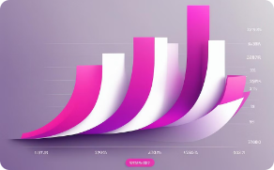


Outcomes of NLP-based Market Basket Analysis
Enhanced Customer Satisfaction
Increased Sales
Optimized Inventory Management
Effective Marketing Strategies
The outcome boosts sales with an upward trending graph, demonstrating positive growth and a modern, professional data visualization.
NLP-based market basket analysis leads to happy customers with full shopping bags, creating a joyful and content atmosphere in bright, sunny shopping malls.
NLP-based analysis leads to organized inventory shelves, tidy warehouses, and efficient stock management, creating a clean and optimized inventory environment.
The project results in targeted marketing campaigns, strategic advertising with dynamic and engaging visual content, and highly effective promotions.

Slide 10




Conclusion
Unlocking Insights
Market basket analysis is a powerful tool that enables businesses to unlock valuable insights from customer transaction data, leading to more informed decisions, tailored product offerings, and enhanced customer experiences.
Driving Business Growth
By leveraging the insights gained from market basket analysis, businesses can optimize their operations, increase sales, and gain a competitive edge in their respective markets, ultimately driving sustainable growth and profitability.
Continuous Improvement
As the field of market basket analysis continues to evolve, with advancements in data analytics, machine learning, and real-time processing, businesses will have even greater opportunities to enhance their decision-making and stay ahead of the curve.

Slide 11
Bibliography
Agrawal, R., Imieliński, T., & Swami, A. (1993). Mining association rules between sets of items in large databases. In Proceedings of the 1993 ACM SIGMOD international conference on Management of data (pp. 207-216).
Brijs, T., Swinnen, G., Vanhoof, K., & Wets, G. (1999). Using association rules for product assortment decisions: A case study. In Proceedings of the fifth ACM SIGKDD international conference on Knowledge discovery and data mining (pp. 254-260).
Han, J., Pei, J., & Yin, Y. (2000). Mining frequent patterns without candidate generation. In Proceedings of the 2000 ACM SIGMOD international conference on Management of data (pp. 1-12).
Tao, F., Murtagh, F., & Farid, M. (2003). Weighted association rule mining using weighted support and significance framework. In Proceedings of the ninth ACM SIGKDD international conference on Knowledge discovery and data mining (pp. 661-666).

Slide 12


